Slide 1
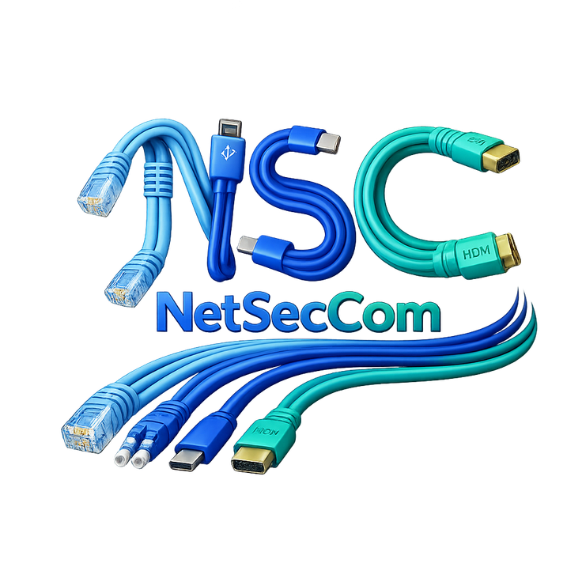
NETSECCOM
Providing Network, Security and Computing support for small to medium sized business
www.netseccom.com

Slide 2
About us
NetSecCom is an IT Managed Services Provider tailored to provide services relating to Networking, Information Security and Computing. We help organizations meet their IT needs by understanding what they have, what they need and what they want. Our focus is on creating custom solutions that fit our customers needs and budgets. From large full scale deployments, migrations, and cutovers to small break-fix troubleshooting NSC aims to be the one stop shop for all technical business needs.

Slide 3
Who We Serve
We provide solutions for all types of IT. Local, state and federal government, education facilities, healthcare organizations, non profits, military, public safety and many more. We provide Temporary, Temp-to-Hire, Contract, and Direct Hire help for our customers. The leadership team's deep expertise in enterprise technology enables NetSecCom to navigate complex implementation challenges and deliver high-value, scalable solutions.

Slide 4
Our Services
1.
Networking- Design, Monitoring and Maintenance of all networked devices. Keeping all devices connected and optimized.
2.
Security- Providing network and endpoint security, risk assesment, firewall, threat management, and compliance support.
3.
Computing- Enabling productibity by managing IT services, providing Help Desk Support, conducting hardware and software installations and implementing cloud solutions.

Slide 5
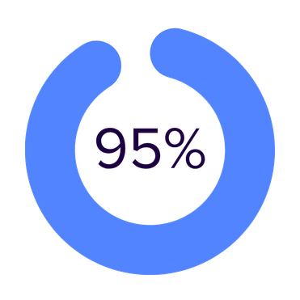
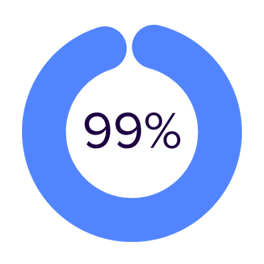

The data
Our customers become 95% compliant with certification and accrediation frameworks such as NIST, ISO and CMMI.
Our SLAs ensure our clients have 99% uptime for their critical network devices. Outages cause loss in revenue and it is our mission to ensure our customers make money instead of losing it.
Our reviews and metrics from our customers give us a 100% satisfaction rating. We resolve our customers issues and take proper action on tasks that can't immediately be fixed.

Slide 6
Our vision is to be a leading IT support provider for customers all over the world. To create a future where organizations operate with confidence, knowing their technology is secure, resilient, and always working for them—not against them.
01. Our Brand Vision

Slide 7
02. Our
Brand Mission
Our vision is to provide affordable IT support based upon our customers needs.
Many IT companies push industry standard technologies onto their customers. This is fine as the industry standard is the best template to use, however we focus on listening to our customers needs and providing what concerns them. We may not understand the intricates of each type of business. We rely on our customers to provide their critical business needs and we develop solutions for them.

Slide 8
03. Our
Brand Purpose
We love technology. We are simply doing what we love doing.
We get excited about unboxing new equipment and preparing to set it up. We are gamers, tinkerers, and engineers. We have years of experience, certifications, degrees and training in different tracts of IT. Helping others provides satisfaction to us. We are doing our part in helping those around us.

Slide 9
We provide support
We provide support to our customers to ensure that the technology is working for them.
IT support is what we do. We provide solutions to solve simple and complex problems. We provide technical recommendations to streamline business processes. We provide configurations to enable devices to operate at their full potential. We help our customers however they need to be helped.

Slide 10
Objectives
Improve Reliability
Strengthen Security
Increase Efficiency
Support Growth
Reduce downtime and service interruptions by implementing proactive monitoring, maintenance, and rapid response support for all critical systems.
Enhance cybersecurity posture through layered security controls, regular assesments and compliance with industry frameworks such as NIST and ISO
Streamline IT operations by optimizing networks, endpoints, and cloud services to improve productivity and reduce operational costs.
Provide scalable IT solutions that grow with our customers, supporting expansion, remote work, and evolving technology needs.

Slide 11
We design and manage reliable backup and disaster recovery solutions to protect critical business data. Our approach ensures that data is securely backed up, easily recoverable, and aligned with business continuity goals.
We help organizations minimize data loss and downtime by implementing tested recovery plans that restore operations quickly after outages, cyber incidents, or system failures.
Backup and Recovery

Slide 12
Networking
Secure network design, deployment, monitoring, and management to ensure fast, reliable, and resilient connectivity.
Cable Management
  LAN/Telephone closet rewire– Allow us to clean up the jungle of wires in your LAN room to make it appealing to look at and easier to understand
  Cable runs– Running cable in the ceilings, behind walls, and between floors
  Replace cables– Replace damaged cables, ethernet plugs, and connections
Remote sites/Branch Office enablement
  Site to Site VPN– Allow communication between branch offices and Headquarters
  Shared Drives– Allow users at different sites to access the same documents
  Centralized Management- Control all devices at remote sites from Headquarters
Enable remote access– Securely enable employees to work remotely
  Establish Virtual Private Network(VPN)– Allow users to connect from anywhere
  BYOD(Bring Your Own Device)– Allow users to use their own computers
  MDM(Mobile Device Management)– Manage phones, tablets and devices with company data on them
  Cloud Migration– Moving services to the cloud so they are available from anywhere
Network equipment
  Installation, troubleshooting, and maintenance of switches, routers, firewalls, wireless controllers, access points, load balancers and many more.

Slide 13
Comprehensive Cybersecurity Services. Proactive protection, monitoring, and response services designed to secure networks, endpoints, identities, and data while maintaining compliance and business continuity.
Security Assessment
  Compliance– Ensure your systems are up to code with your governing regulations
  Vulernability Scanning– Search and identify possible entry points hackers can use on your network
  Risk Management– Identify and classify some of the known and unknown risks that you may be facing as an organization
  Remediation– Resolve any and all of the findings from the above tasks
Malware Management
  Find and remove viruses
  Identify and avoid adware
  Detect and eliminate spyware
  Prevent computer infections
System Update and Patching
  Keep systems up-to-date to access the latest features available
  Fix issues with software that are identified by their vendor
  Patch security holes on your system that can possible be accessed by hackers
Security

Slide 14
Virus and Malware Help
1.
Detection and Removal- Identify, isolate, and safely remove viruses, malware, and ransomware from infected systems.
2.
Prevention and Hardening- Implement security controls, endpoint protection, and user best practices to prevent future infections.
3.
Recovery and Education- Restore affected systems and data while educating users to reduce the risk of recurring incidents.

Slide 15
Computing
We manage and support end-user computing environments to ensure reliability and productivity. Our services include hardware deployment, software installation, patching, and cloud integration.
From help desk support to full system lifecycle management, we ensure technology enables users to work efficiently and securely.
Computing Assessment– Allow us to perform a computing assessment to possibly find the following
  Devices operating slowly or poorly
  Errors in systems that are affecting performance
  Inventory and documentation of systems
  Capacity limitations
Customer/Computer Support
  HelpDesk– Onsite or Remote assistance with day to day user and computer problems from Tier 1 to Tier 3
  Server Administration– Upkeep, maintenance, and optimization of business critical servers to prevent failures and downtime
  Break-Fix– On-Call support to resolve issues when they arise
Business Continuity and Disaster Recovery
  Backup and Recovery– Backing up company data so it can be restored if accidentally damaged or deleted
  Off-site replication– Save data to a different site, or to cloud so it can be accessed even if the entire site is destroyed
  Failover/Clustering– Group servers together so if one crashes, the other can handle the load
Cloud migration
  Create a plan to move services to the cloud to eliminate on prem maintenance of servers.
  Setup of full cloud, or hybrid cloud environment.
  Office 365, Azure, and Amazon AWS solutions to meet business needs.
  Save on energy consumption, server cooling costs, and hardware licensing by migrating services to the cloud.

Slide 16
Contact
EMAIL
PHONE
robert@netseccom.com
+1-240-462-4059
ADDRESS
WEBSITE
306 W Redwood St STE 200 Baltimore, MD, 21201, USA
netseccom.com

